Slide 1

SWIFT UAV
Structural Systems v0.2.3

Slide 2
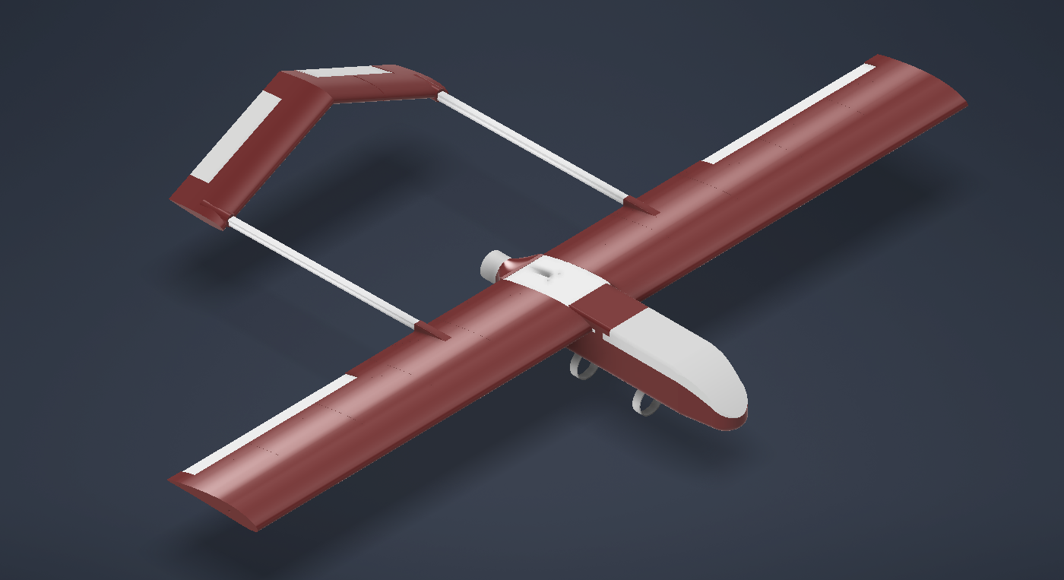
Design & Manufacturing Progress
Current design iteration is focused on:
Structural improvements
Operational improvements
Design for manufacturability
The current (v0.2.3) UAV design is in production
Initial prints confirm the validity of design changes

Slide 3
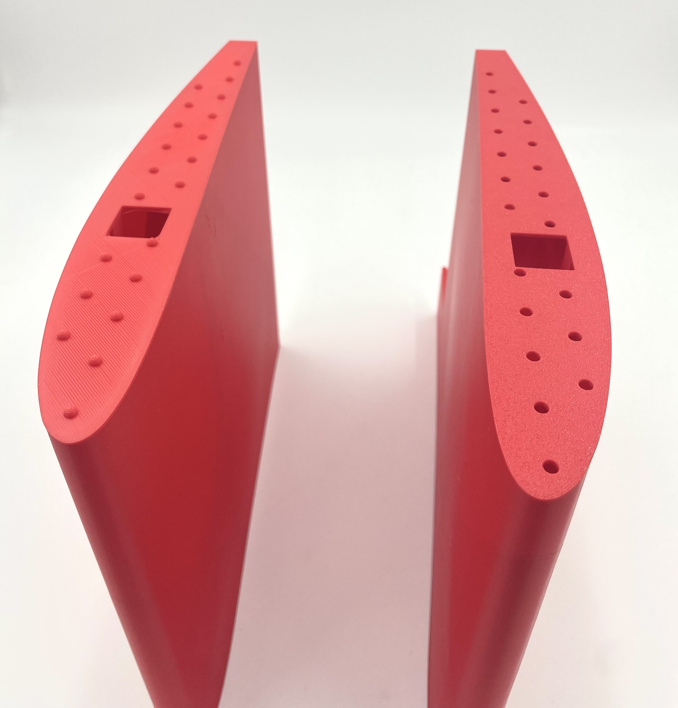
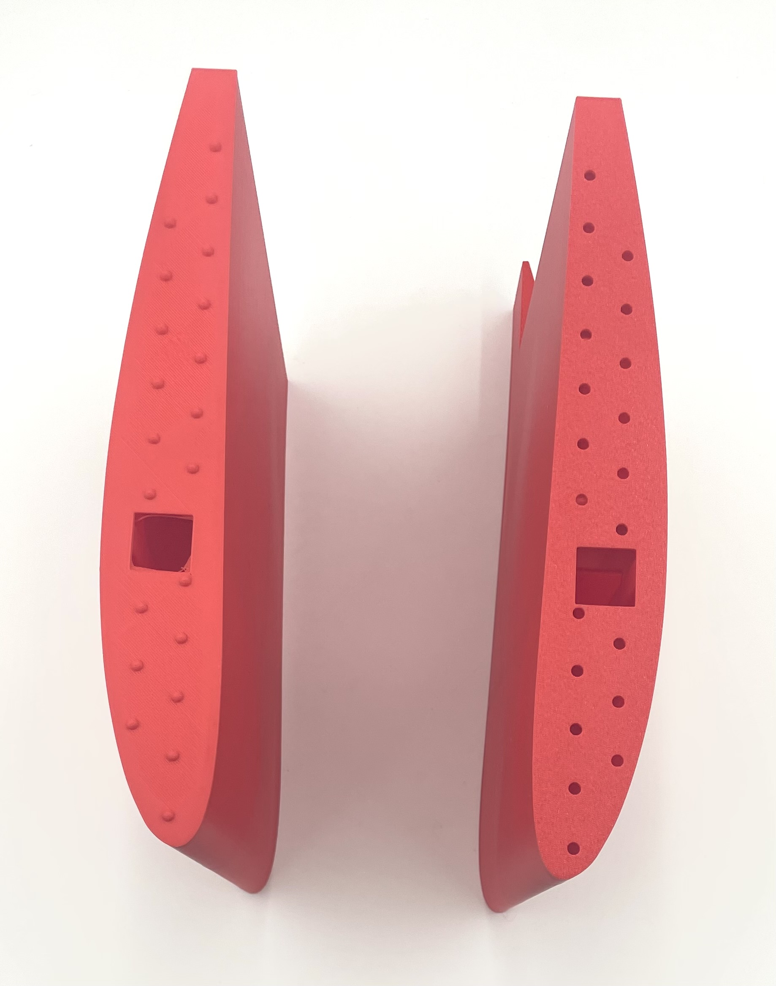
Structural Modifications for Assembly
Locking nubs have been added between wing segments
They provide multiple structural and functional benefits:
Load Transfer: Enables transfer of shear loads between wing sections
Improved Assembly: Enables part indexing for easy assembly
Torsional Stiffness: Increases torsional resistance substantially

Slide 4
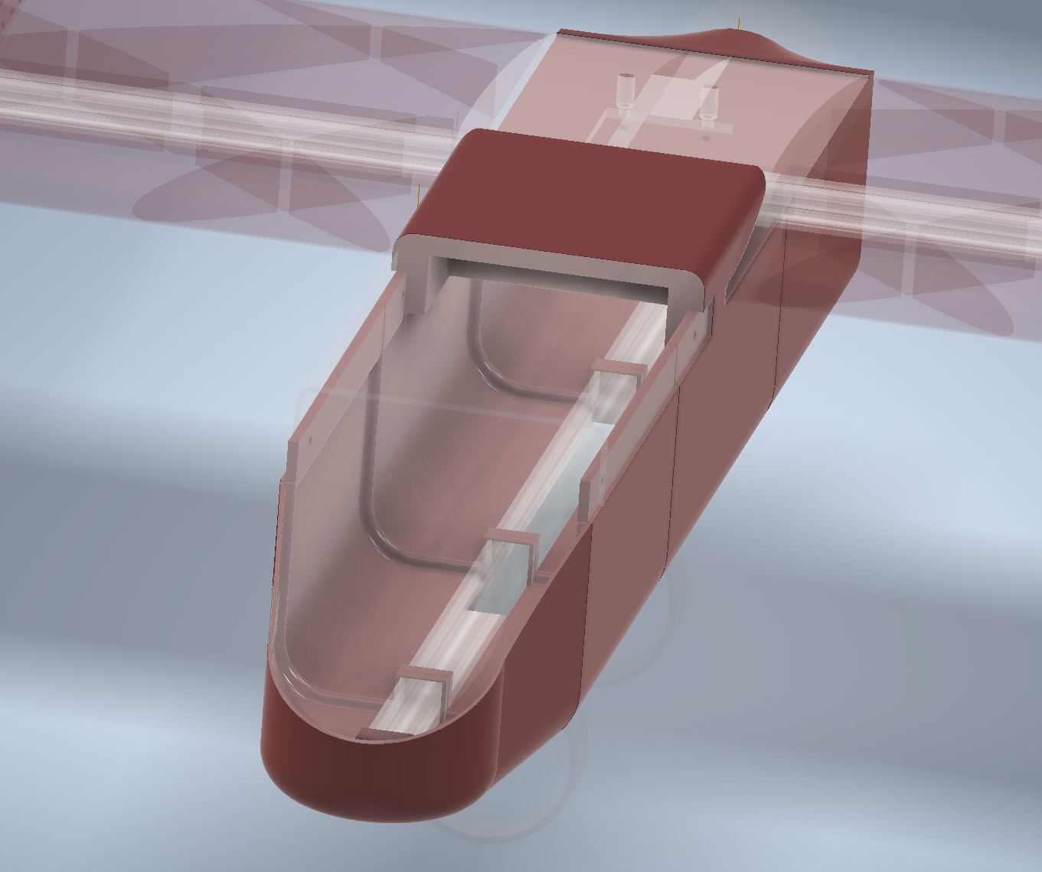
Structural Modifications for Assembly
Tabs have been added to fuselage sections
Provides indexing points to streamline manufacturing and increase joint rigidity
A slot has been added to the fuselage cover, allowing rapid access to internal systems for inspection, testing, or quick component replacement.

Slide 5


Avionics Integration
Avionics integration is being conducted in parallel with the 3D printing, ensuring that mounting provisions and clearances are accounted for as well as reducing total build time.
A 20×20 mm T-slot aluminum bar has been embedded into the fuselage base.
This bar provides a universal mounting interface for avionics trays and payloads.
Allows for easy reconfiguration between different missions or experimental setup and reduces the need for additional structural modification when introducing new equipment.

Slide 6
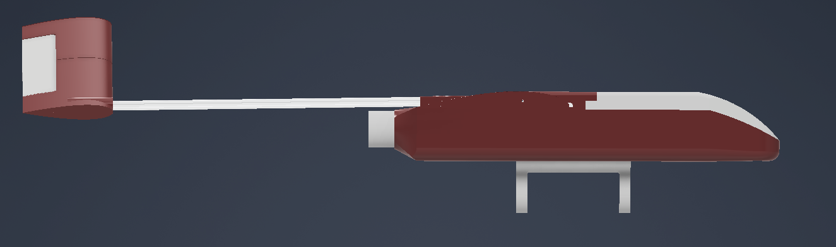
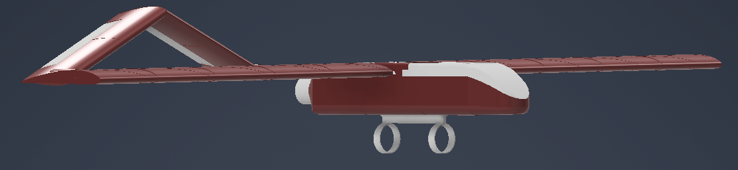
Future Payload Accommodation
A pylon structure has been upgraded to support the mounting of additional mission-specific equipment, such as environmental sensors. This structure opens the door for collaborative research projects, where external partners can attach their instrumentation without altering the main aircraft structure. Future upgrades may include quick-release interfaces.

Slide 7
Thank You for Your Time
Lab GitHub: github.com/arts-laboratory

